Slide 1

post.it
Content Management System
Final Year Project
Dhruv Saxena
BCA – III Year
Roll no - A/7412

Slide 2
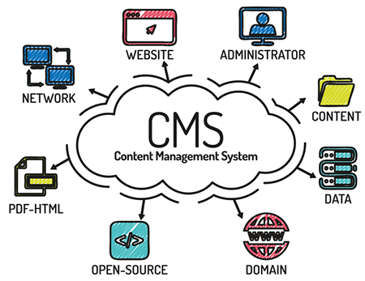
CONTENTS
Overview of the project
Technology Used
Features
Project Description
Database
Interface
Future Scope
References

Slide 3
Overview of the project
post.it application system is used to store the details of posts, categories, comments, created by the administrator which will be managed by the application itself. ie. All the posted, comments, categories are sorted by date as they needed to be.
It will be used to store and manage content of user.
Users can use this project as their own blogs.
It’s for all who are newbie to this field as well as who specifically wants their own system to manage content for them.

Slide 4

Technology Used
PHP Stands for “Hyper Text Pre Processor “.
It is widely used Open-source scripting language that is especially suited for web-development and can be embedded into HTML.
It is fast and stable.
It is cross platform language
Compatible with all kinds of server and all kinds of operating system.
No compilation needed.
It is easy to learn but very powerful.

Slide 5








Other Technology Used
HTML5
CSS3
JavaScript
MySQL

Slide 6

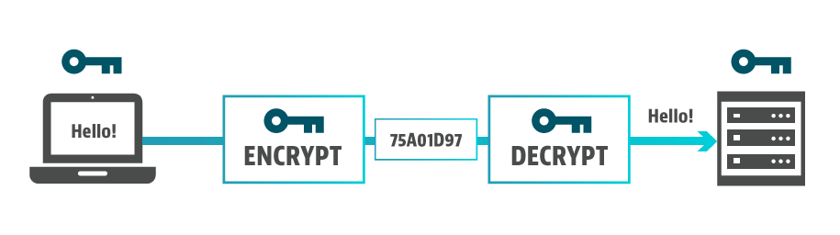
Features
The user can perform multiple operations as addition with CRUD ( Create, Retrieve, Update, Delete).
The admin can create new posts, new categories, new content writers(users will less powers).
Easy to use, we kept important functionality with minimalism.
Easy to manage content data.
Secure from SQL Injections
Encrypted
Increase flexibility of website

Slide 7
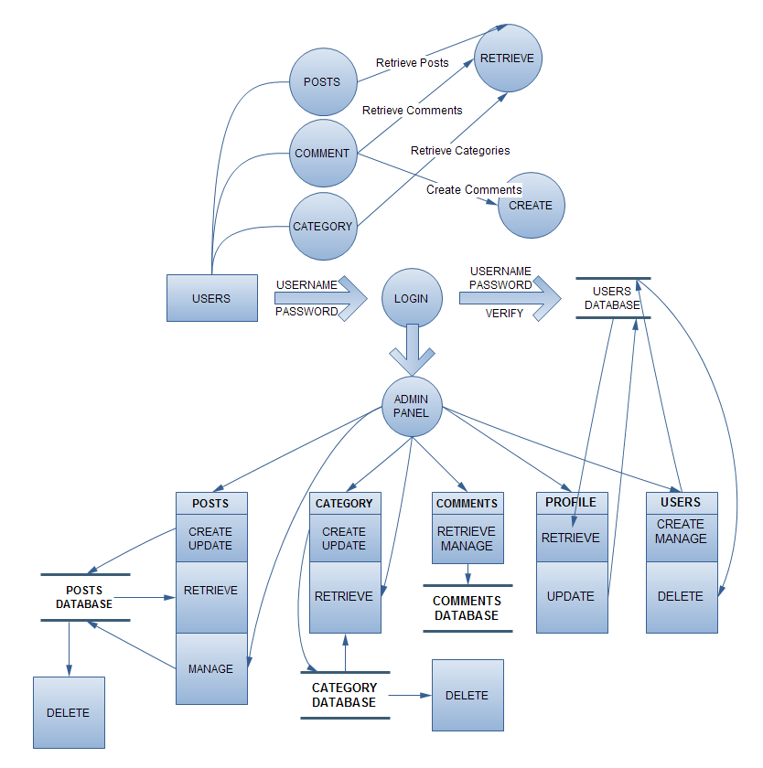
Project Description - DFD

Slide 8
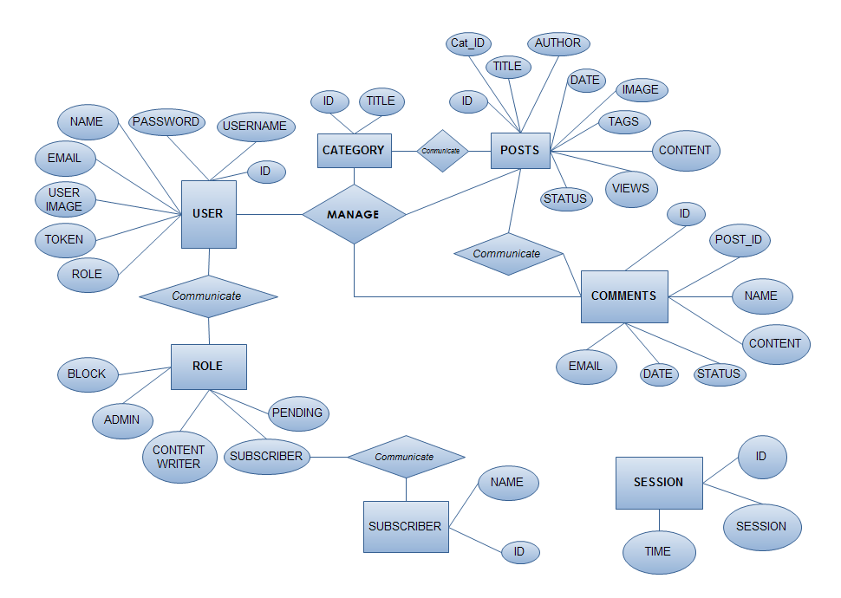
Project Description - ERD

Slide 9



Database using PHP
WEB SERVER
Obtain data
Dynamic Page
Page Request

Slide 10
Working with database in PHP
Configuration
#1 $db['db_host'] = "localhost";
#2 $db['db_user'] = "root";
#3 $db['db_pswrd'] = "";
#4 $db['db_name'] = "cms";
#5
#6 foreach($db as $key => $value){
#7 define(strtoupper($key),$value);
#8 }
#9
#10 $connect = mysqli_connect(DB_HOST,DB_USER,DB_PSWRD,DB_NAME);
#11
#12 if(!$connect) die(mysqli_error($connect));

Slide 11
Executing Queries
#1 function escape($string){
#2 global $connect;
#3 return mysqli_real_escape_string($connect,trim($string));
#4 }
#5
#6 function redirect($location){
#7 header(“Location:$location”);
#8 }
#9
#10 function query($query){
#11 global $connect;
#12 return mysqli_query($connect,$query);
#13 }

Slide 12
Insertion Query
#1 $stmt = mysqli_prepare($connect,
"INSERT INTO posts
(post_title,cat_id,post_author,post_img,post_content,post_tag,post_status,post_date)
VALUES(?,?,?,?,?,?,?,now())");
#2 mysqli_stmt_bind_param($stmt, "sisssss" ,
$postTitle,$cat_id,$postAuthor,$postImg,$postContent,$postTag,$postStatus);
#3 mysqli_execute($stmt);
#4 if(!$stmt){die(mysqli_error($connect));}

Slide 13
Selection Query
#1 $stmt = mysqli_prepare($connect,"SELECT cat_id,cat_title FROM category");
#2 mysqli_stmt_execute($stmt);
#3 mysqli_stmt_bind_result($stmt,$catID,$catTitle);
#4 while(mysqli_stmt_fetch($stmt)){
#5 echo "<tr>";
#6 echo "<td>$catID</td>";
#7 echo "<td>$catTitle</td>";
#8 }

Slide 14




What can a user do ?
User can view all the posts ever posted.
User can create, update, delete posts.
User can manage which post to keep publish(visible to end user),
un-publish(not visible to end user)
User can view all categories.
User can create, update, delete categories.
User can view all the comments posted on which posts of website.
User can manage comments by approving and dis-approving to them.
User(ADMIN) can manage other users(Content-Writers)
User can update their profile and privacy of data.
Only the administrator user have access to user manage field.

Slide 15
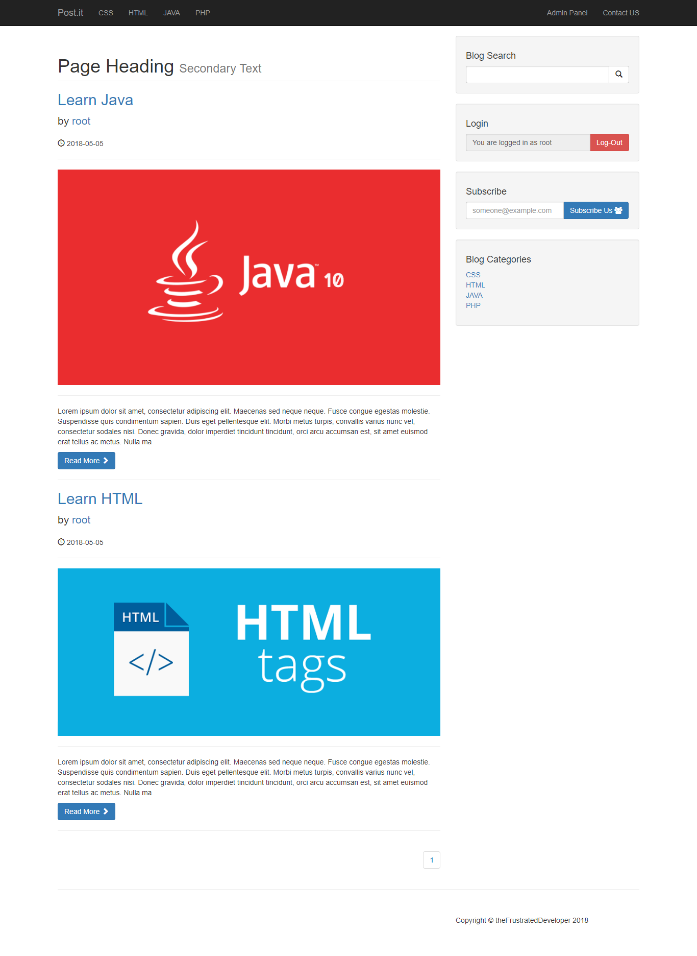
User - Interface
HOMEPAGE

Slide 16
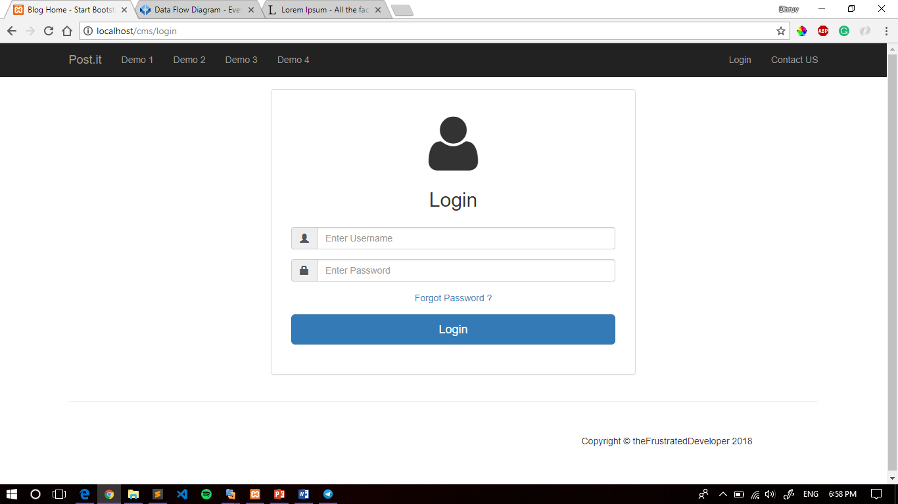
LOGIN - PAGE

Slide 17
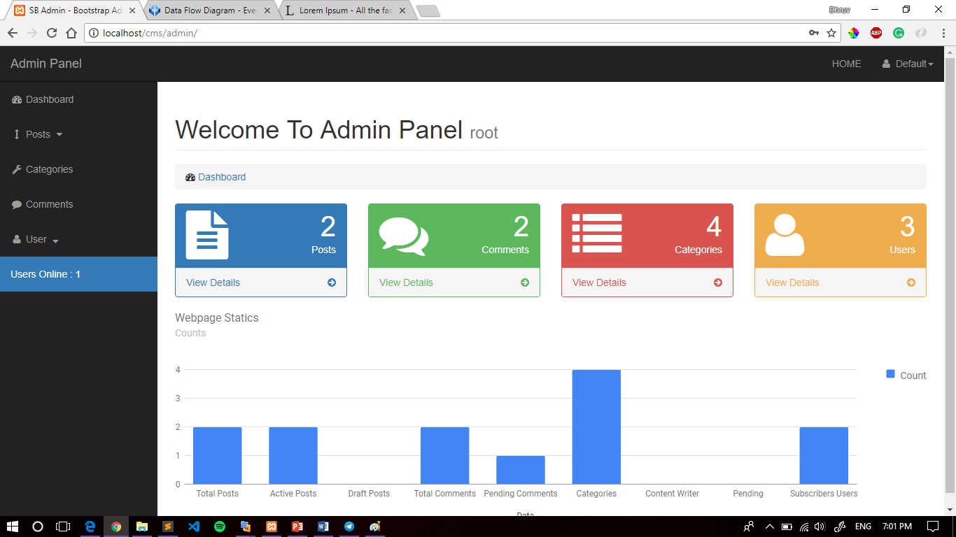

Slide 18
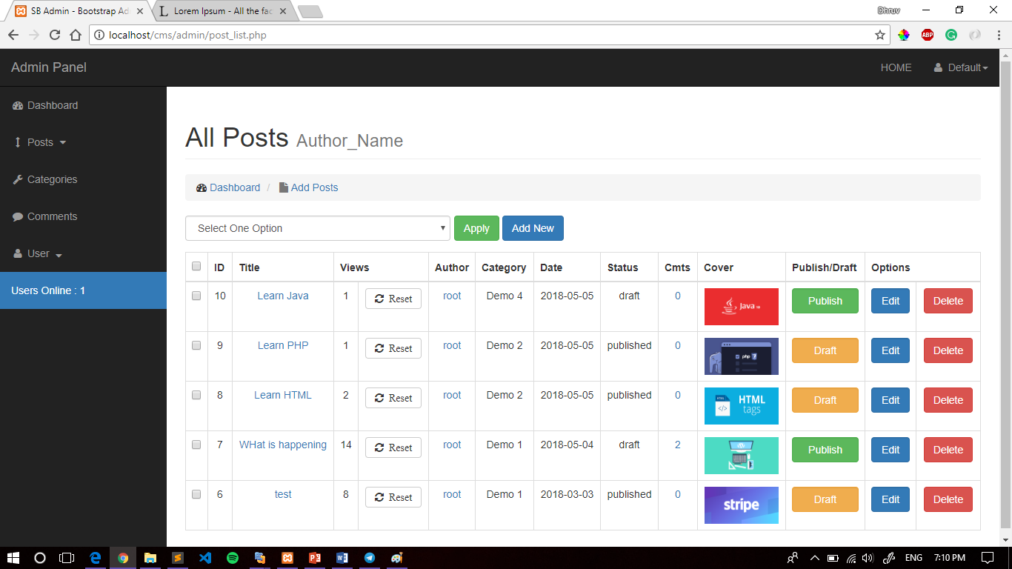

Slide 19
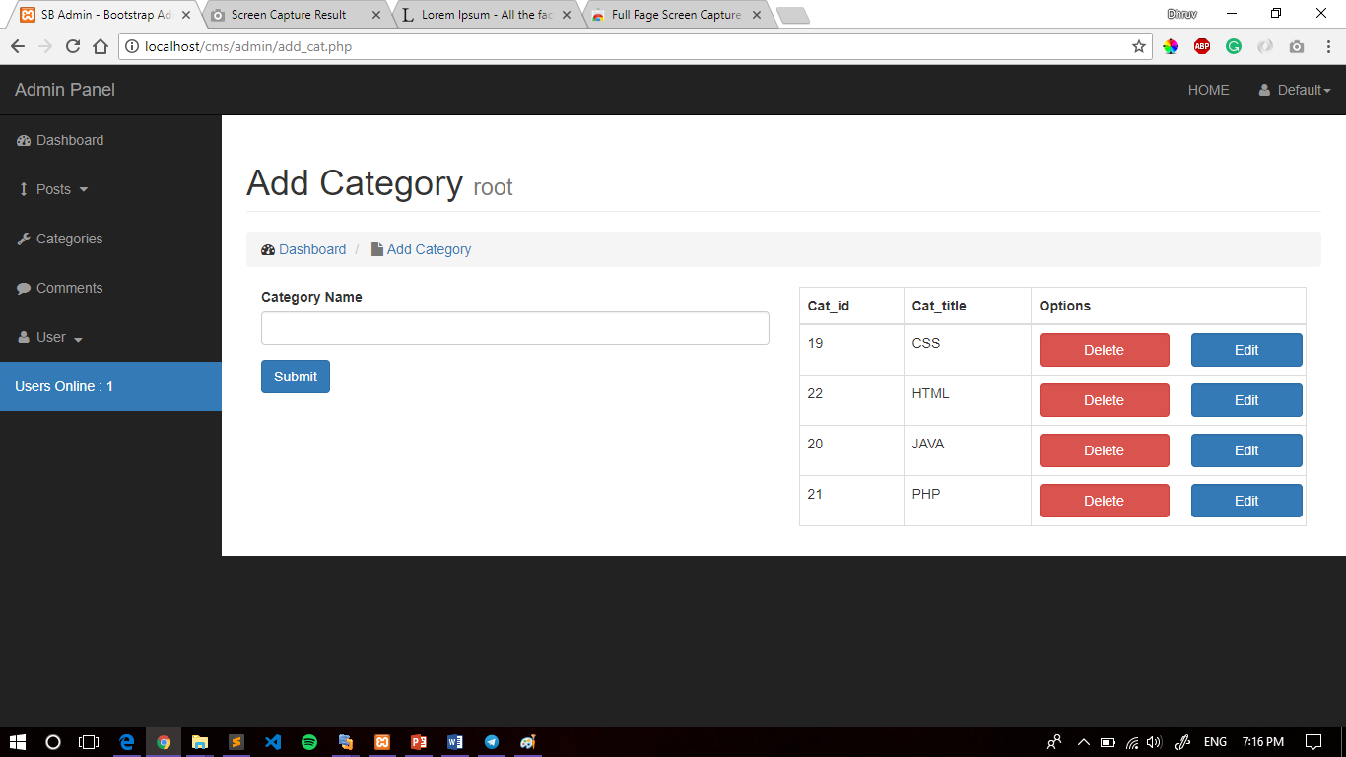

Slide 20
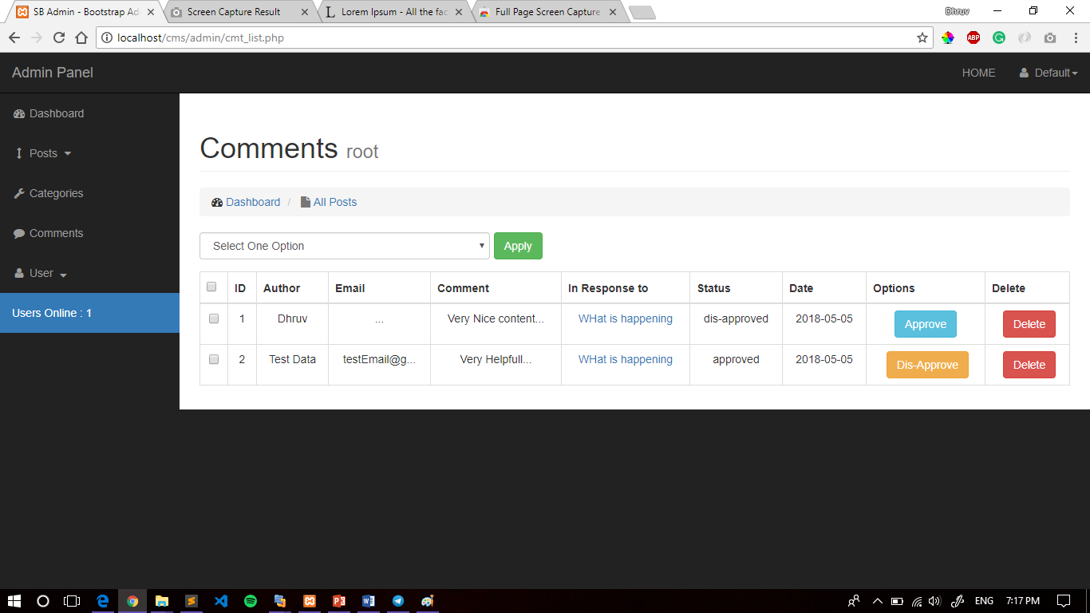

Slide 21
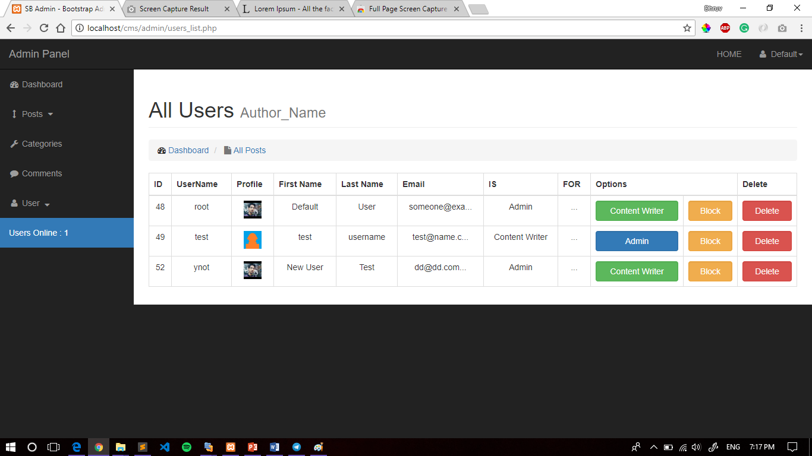

Slide 22
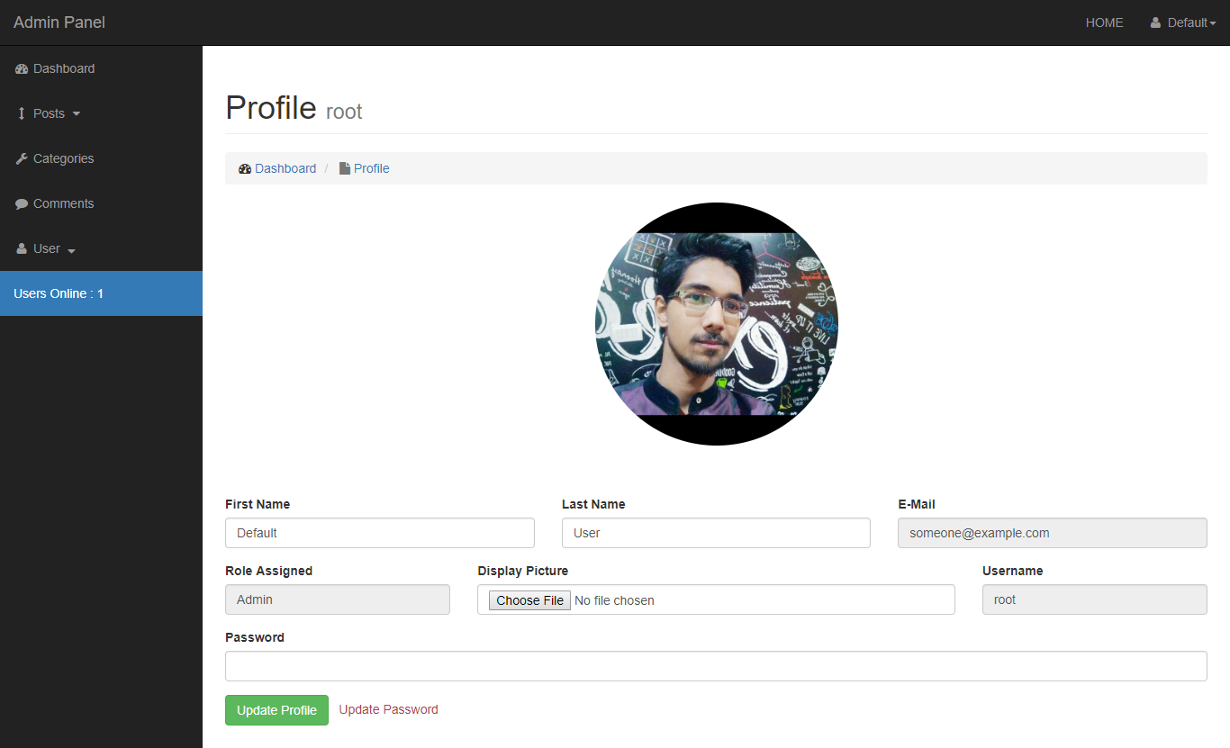

Slide 23
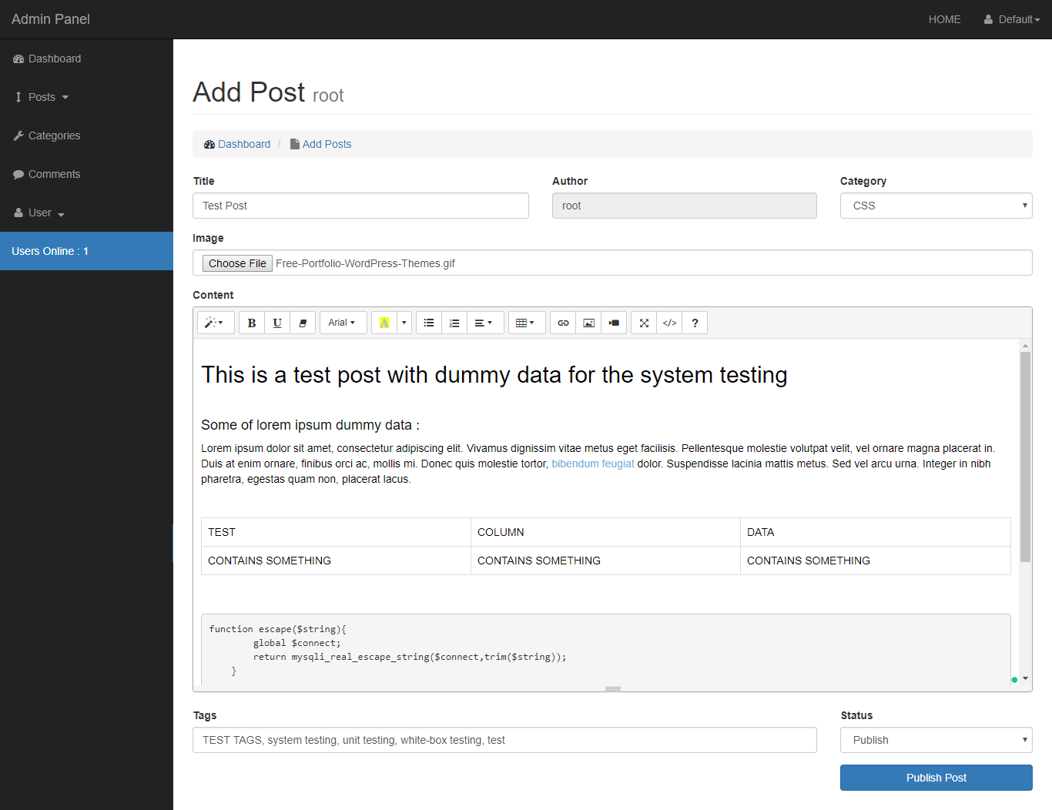

Slide 24
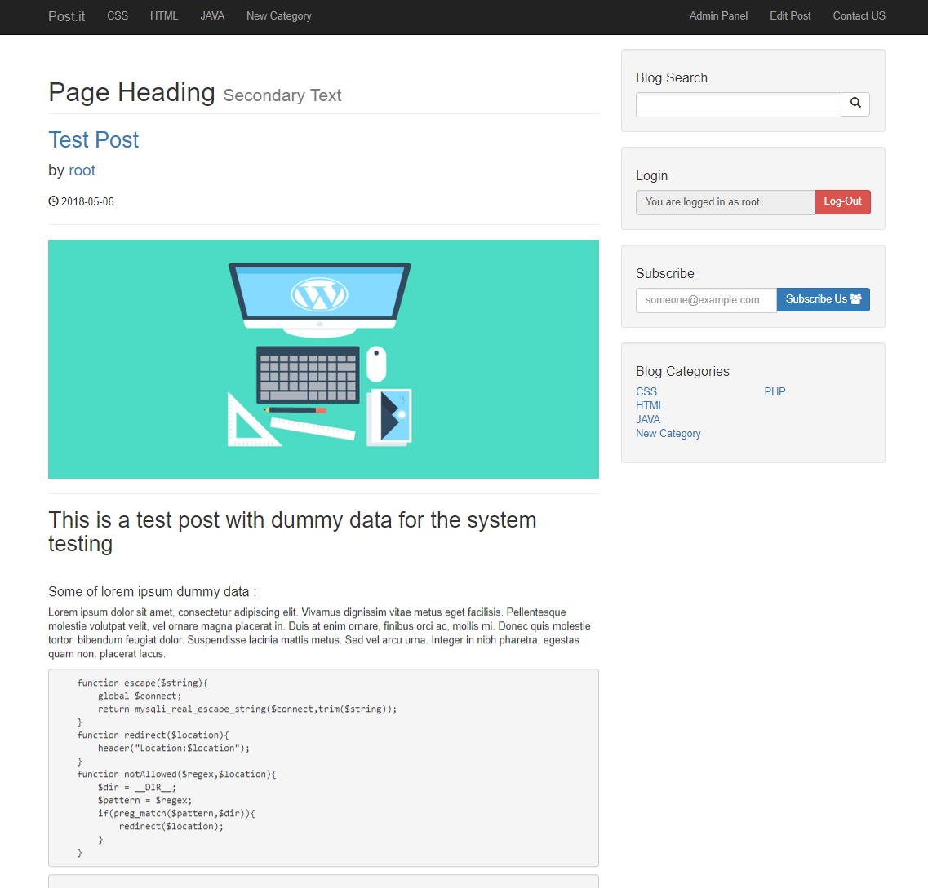

Slide 25
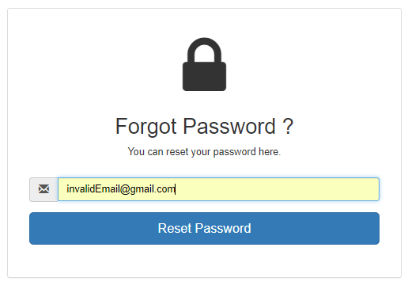
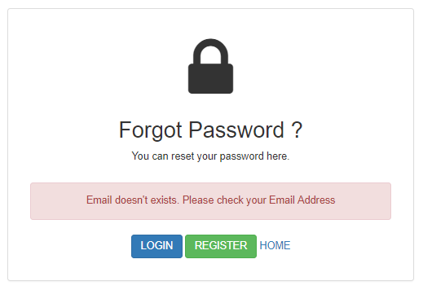

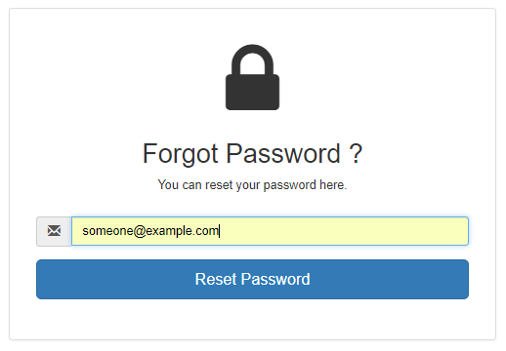
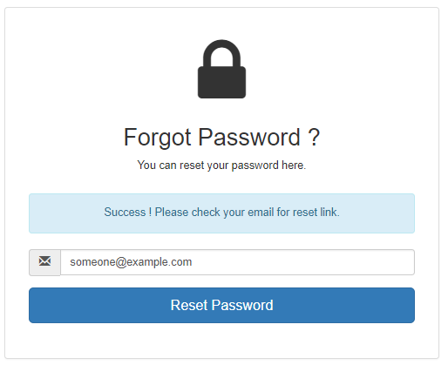


Slide 26
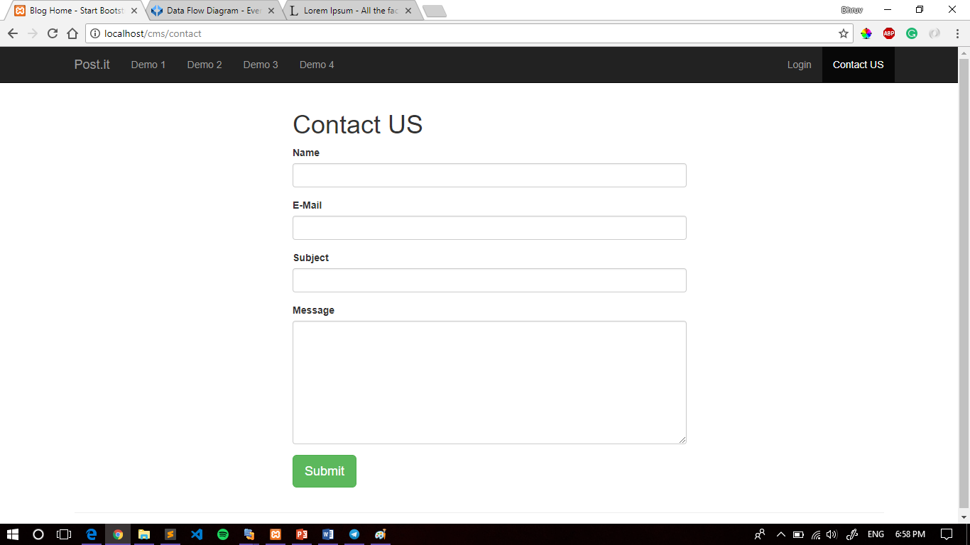

Slide 27



FUTURE SCOPE
Modular Functionality i.e. Widgets
Themes Support
Better Encryption algorithm
More efficient process algorithms
Secure regular updates
Goal is to provide needed functionality yet be minimalism.

Slide 28





REFERENCES
PHP: The Complete reference
PHP.net
Stack Overflow
Udemy
GitHub

Slide 29
THANK YOU
ANY QUERIES ?

